Slide 1
Week 4
Today’s Class:
What is unstructured data and it’s applications
Pre-processing in Text Mining
Sentiment Analysis of data - examples
Prediction model building for textual data – example
What is Word2Vec?

Slide 2

What is unstructured data?
Text, images, speech, videos etc. needs some kind of pre-processing before we can analyze the data meaningfully
Natural Language Processing/ NLP: Converting natural language in to useful machine understandable data using tools and algorithms
CRISP-DM Model for NLP
Corpus of text docs
EDA & Feature Engineering
Based on Business Problem: Supervised/ Unsupervised model

Slide 3
Applications
Speech to text analysis
Sentiment analysis of call center conversations
Triaging customer service call to the correct division
Sentiment analysis for reducing customer churn
Siri, Alexa, Cortana
Machine Language Translation – Eg: Google Translate
Email autofill and automatic summarizers Eg: Gmail, Aylien-API
Chatbots – Eg: Facebook
Themes
Can We Find Words That Are Often Combined
Are Certain Words Correlated With Rankings?
Fighting Spam
Recommender System using Word2Vec
What other applications can you think of??

Slide 4
Packages
R: tm package, NLP
Python: nltk
gensim.models
Word Embedding Types
Frequency based embeddings
Count Vectorizer
TF-IDF Vectorizer
Prediction based embeddings
Word2Vec - CBOW and Skip-gram (Google 2013)
BERT – Bidirectional Encoder Representations from Transformers

Slide 5
Common Pre-processing for NLP Problems:
Sentence Segmentation: break the text apart into separate sentences
Tokenization: split the document in to a list of either sentences or words
Stemming: process of reducing words to their word stem
Lemmatizing: reduces to a common proper word
Remove STOP words (overly common words such as "and", "the", "a", "of", etc.)
Name entity recognition: detect nouns with the real-world concepts
Text classification – using clustering methods
Chunking: Tells you weather words are nouns, verbs, adjectives etc.
Remove undesirable words (manual list of negative words)
Remove words with fewer than three characters (often used for phonetic effect in music)
Split the lyrics into individual words

Slide 6


Term Vs Document Frequency
term frequency (tf): How frequent does a word appear in a document
tf = Frequency of a word in the document/Total words in the document
inverse document frequency (idf): for a given term t, in a set of documents D
idf = Log((Total number of docs)/(Number of docs containing the word))
tf-idf: frequency of a term adjusted for how rarely it is used
Pick the words with the highest tf-idf
Words like harry (in harry potter), the, is may have a high tf but a low tf-idf

Slide 7
How to use STOP words and Stemming
STOP words:
Classic Method - removing STOP words obtained from pre-compiled lists
Methods based on Zipf’s Law - removing most frequent words (TF-High) and removing words that occur once, i.e. singleton words (TF1)
Remove words with low IDF
Stemming – is a judgement call; strips to the root
stemDocument(c("computational", "computers", "computation")) -> "comput"
my_corpus = tm_map(my_corpus, stemDocument)
Does not necessarily return a proper word
Lemmatizing (root word called Lemma)
Outputs a proper word
Eg: worse→ bad, better -> good, run -> run,
Eg: gone, going, went -> go

Slide 8
Sentiment Analysis
Two main approaches:
Lexicon approach- Pre-learned sentiments (will be discussing in class today)
Learning approach – Recurrent NN's (with LSTM) and word2vec
Lexicon Approach: is some type of a vocabulary, dictionary
Dictionaries of words with an assigned sentiment category or value
AFINN: assigns words with a score that runs between -5 and 5, with negative scores indicating negative sentiment and positive scores indicating positive sentiment
Bing: assigns words into positive and negative categories - binary
NRC: assigns words into one or more of the following ten categories: positive, negative, anger, anticipation, disgust, fear, joy, sadness, surprise, and trust

Slide 9
Word2Vec
How is word2vec performed?
One Hot Encoding to Word Embeddings
Common Bag Of Words (CBOW):
one-hot-encoding of each word as the input and tries to predict the word corresponding to the context
given a set of context provides the probability of the input word
CBOW is faster and has better representations for more frequent words
Doesn’t differentiate between “Apple” the fruit and “Apple” the company
Skip-Gram
Input is the target word and outputs a probability distribution for each word in the context
works well with small amount of data and is found to represent rare words well
Capture multiple semantics of the same word E.g. differentiates between “Apple” the fruit and “Apple” the company

Slide 10
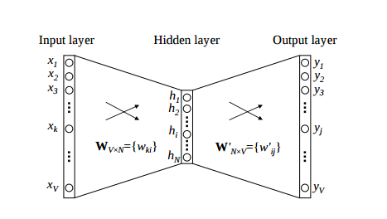
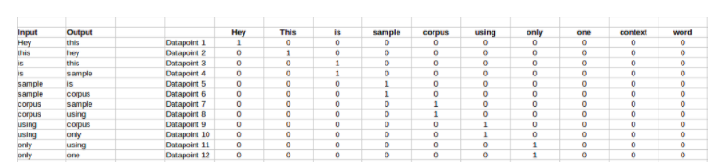
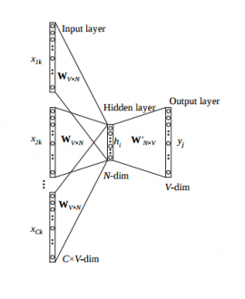
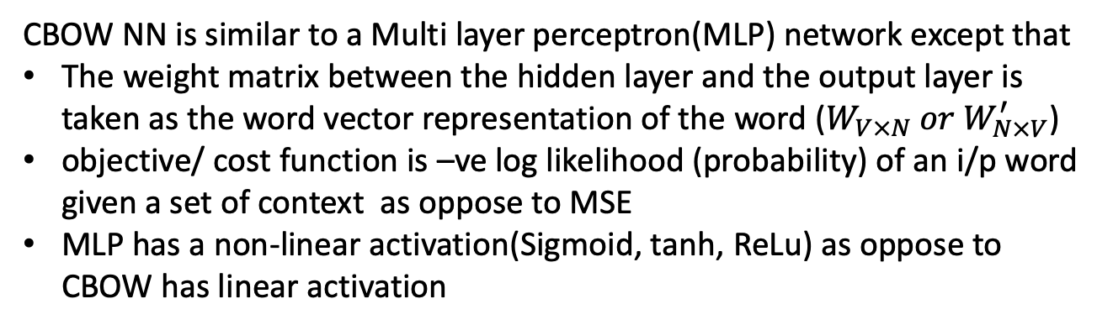
Word2Vec – CBOW
C = “Hey this is sample corpus using only one context word”
Context Window length = 1
CBOW NN is similar to a Multi layer perceptron(MLP) network except that
The weight matrix between the hidden layer and the output layer is taken as the word vector representation of the word ($W_{V×N} or W_{N×V}^{′}$)
objective/ cost function is –ve log likelihood (probability) of an i/p word given a set of context as oppose to MSE
MLP has a non-linear activation(Sigmoid, tanh, ReLu) as oppose to CBOW has linear activation
Context Window length = 3

Slide 11
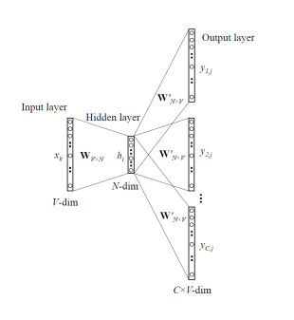
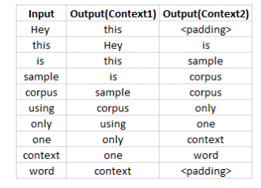
Word2Vec – Skip-gram
C = “Hey this is sample corpus using only one context word”
Skip-Gram predicts the context given the input word

Slide 12
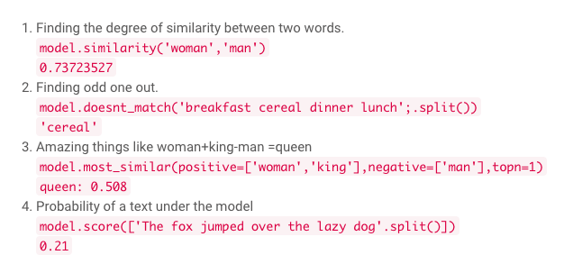
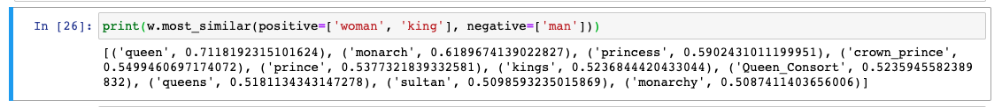
Word2Vec
Using Google pre trained model, trained on 1 Billion words from Google news dataset; loaded via genism.models API
model = Word2Vec.load_word2vec_format('GoogleNews-vectors-negative300.bin', binary=True, norm_only=True)
Test Word2Vec: https://ronxin.github.io/wevi/
Homework read:
https://www.analyticsvidhya.com/blog/2019/07/how-to-build-recommendation-system-word2vec-python/

Slide 13
BERT – Bidirectional Encoder Representation from Transformers (Google 2018)
Problems to solve
Neural Machine Translation
Question Answering
Sentiment Analysis
Text summarization
How to solve problems
Pre-trained BERT models to understand language (case and uncases in tf_hub)
Fine tune BERT to learn a specific task – Transfer learning
Pre-training BERT
Masked Language model Eg: Is he [MASK1] to college [MASK2]?
Next sentence prediction Eg: (A)Kasun is from Sri Lanka. (B)He lives in Gloucester now.

Slide 14
Class Exercise-
#AAPL tweets before and after releasing Revenue statements
Obama vs Romney speeches classification using kNN algorithm

Slide 15
Today’s Project - Sentiment Analysis of Airlines
Read "Short Intro to R Package tm"
Import the dataset – next slide
Run the Sentiment analysis on the textual data
Analyze the sentiments by Airline, Day of Week, Lexicon method etc.
Graphically represent your findings
Compare and contrast sentiments and number of tweets based on Airline
What is your Conclusion?

Slide 16
Appendix
library(foreign)
library(syuzhet)
library(lubridate)
library(plyr)
library(ggplot2)
library(tm)
library(wordcloud)
# get the data for the tweets
dataURL = 'https://s3-ap-southeast-1.amazonaws.com/colinpriest/tweets.zip'
if (! file.exists('tweets.zip')) download.file(dataURL, 'tweets.zip')
if (! file.exists('tweets.dbf')) unzip('tweets.zip')
tweets = read.dbf('tweets.dbf', as.is = TRUE)

Slide 17
Sources:
https://nlp.stanford.edu/IR-book/html/htmledition/irbook.html
https://uc-r.github.io/tidy_text
https://uc-r.github.io/sentiment_analysis
https://towardsdatascience.com/a-practitioners-guide-to-natural-language-processing-part-i-processing-understanding-text-9f4abfd13e72
https://towardsdatascience.com/introduction-to-word-embedding-and-word2vec-652d0c2060fa
https://www.analyticsvidhya.com/blog/2019/07/how-to-build-recommendation-system-word2vec-python/
https://www.analyticsvidhya.com/blog/2017/06/word-embeddings-count-word2veec/

